Slide 1
Data Modeling _ Building the Entity Relationship Diagram (ERD)
Chapter 7_2
7 - <number>

Slide 2

ERD Basics
Drawing the ERD is an iterative process of trial and revision
ERDs can become quite complex
7 - <number>
PowerPoint Presentation for Dennis, Wixom, & Roth Systems Analysis and Design, 3rd Edition
Copyright 2006 © John Wiley & Sons, Inc. All rights reserved.
.

Slide 3
Steps in Building ERDs
Identify the entities
Add attributes and assign identifiers
Identify relationships
Identify the Cardinality constraint
Draw the ERD
Check the ERD
7 - <number>
PowerPoint Presentation for Dennis, Wixom, & Roth Systems Analysis and Design, 3rd Edition
Copyright 2006 © John Wiley & Sons, Inc. All rights reserved.
.

Slide 4

Identify the Entities
Identify major categories of information
  If available, check the process models for data stores, external entities, and data flows
  Check the major inputs and outputs from the use cases
Verify that there is more than one instance of the entity that occurs in the system
7 - <number>
PowerPoint Presentation for Dennis, Wixom, & Roth Systems Analysis and Design, 3rd Edition
Copyright 2006 © John Wiley & Sons, Inc. All rights reserved.
.

Slide 5
Add Attributes and Assign Identifiers
Identify attributes of the entity that are relevant to the system under development
  Check the process model repository entries for details on data flows and data stores
  Check the data requirements of the requirements definition
  Interview knowledgeable users
  Perform document analysis on existing forms and reports
Select the entity’s identifier
7 - <number>
PowerPoint Presentation for Dennis, Wixom, & Roth Systems Analysis and Design, 3rd Edition
Copyright 2006 © John Wiley & Sons, Inc. All rights reserved.
.

Slide 6
Map Attributes
For each attribute we need to match it with exactly one entity. Often it seems like an attribute should go with more than one entity (e.g. Name). In this case you need to add a modifier to the attribute name to make it unique (e.g. Customer Name, Employee Name, etc.) or determine which entity an attribute "best' describes.
If you have attributes left over without corresponding entities, you may have missed an entity and its corresponding relationships. Identify these missed entities and add them to the relationship matrix now.

Slide 7
Identify Relationships
Start with an entity and identify all entities with which it shares relationships
Describe the relationship with the appropriate verb phrase
Determine the cardinality and modality by discussing the business rules with knowledgeable users
7 - <number>
PowerPoint Presentation for Dennis, Wixom, & Roth Systems Analysis and Design, 3rd Edition
Copyright 2006 © John Wiley & Sons, Inc. All rights reserved.
.

Slide 8
Key Definitions
Data model
  A formal way of representing the data that are used and created by a business system
  Shows the people, places and things about which data is captured and the relationships among them.
Logical data model
  shows the organization of data without indicating how it is stored, created, or manipulated.
7 - <number>
PowerPoint Presentation for Dennis, Wixom, & Roth Systems Analysis and Design, 3rd Edition
Copyright 2006 © John Wiley & Sons, Inc. All rights reserved.
.

Slide 9
ERD Building Tips
Data stores of the DFD should correspond to entities
Only include entities with more than one instance of information
Don’t include entities associated with implementation of the system (they will be added later)
7 - <number>
PowerPoint Presentation for Dennis, Wixom, & Roth Systems Analysis and Design, 3rd Edition
Copyright 2006 © John Wiley & Sons, Inc. All rights reserved.
.

Slide 10
A Simple Example
A company has several departments. Each department has a supervisor and at least one employee. Employees must be assigned to at least one, but possibly more departments. At least one employee is assigned to a project, but an employee may be on vacation and not assigned to any projects.
The important data fields are the names of the departments, projects, supervisors and employees, as well as the supervisor and employee number and a unique project number.

Slide 11
Identify entities
One approach to this is to work through the information and highlight those words which you think correspond to entities.
A company has several departments. Each department has a supervisor and at least one employee. Employees must be assigned to at least one, but possibly more departments. At least one employee is assigned to a project, but an employee may be on vacation and not assigned to any projects.
The important data fields are the names of the departments, projects, supervisors and employees, as well as the supervisor and employee number and a unique project number.
A true entity should have more than one instance

Slide 12
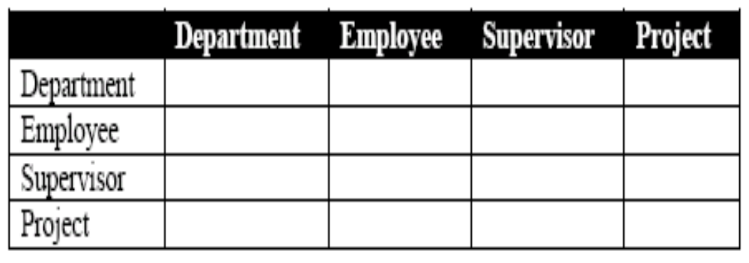
Find Relationships
Aim is to identify the associations, the connections between pairs of entities.
A simple approach to do this is using a relationship matrix (table) that has rows and columns for each of the identified entities.

Slide 13
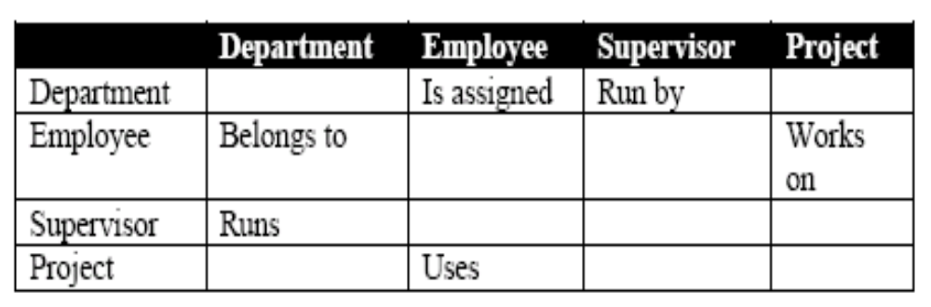
Find Relationships (Contd.)
Go through each cell and decide whether or not there is an association. For example, the first cell on the second row is used to indicate if there is a relationship between the entity "Employee" and the entity "Department".

Slide 14
Identified Relationships
Names placed in the cells are meant to capture/describe the relationships. So you can use them like this
A Department is assigned an employee
A Department is run by a supervisor
An employee belongs to a department
An employee works on a project
A supervisor runs a department
A project uses an employee

Slide 15


Drawing Rough ERD (Contd.)

Slide 16
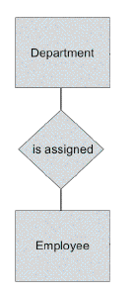
Drawing Rough ERD (Contd.)

Slide 17
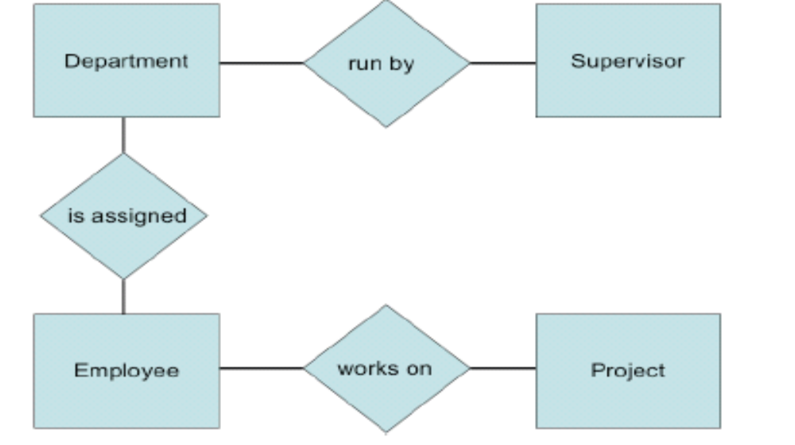
Drawing Rough ERD (Contd.)

Slide 18
Fill in Cardinality
Supervisor
  Each department has one supervisor.
Department
  Each supervisor has one department.
  Each employee can belong to one or more departments
Employee
  Each department must have one or more employees
  Each project must have one or more employees
Project
  Each employee can have 0 or more projects.

Slide 19
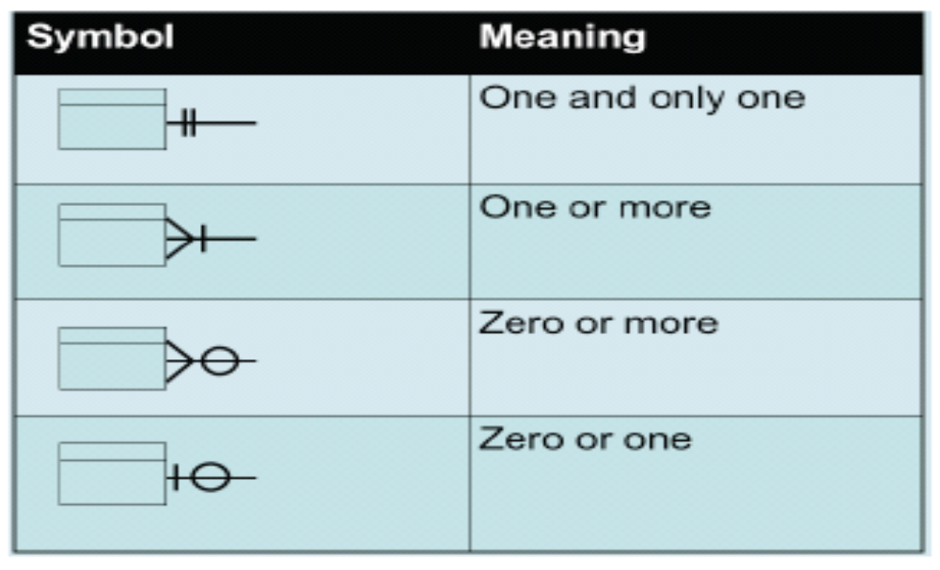
Cardinality Notation

Slide 20
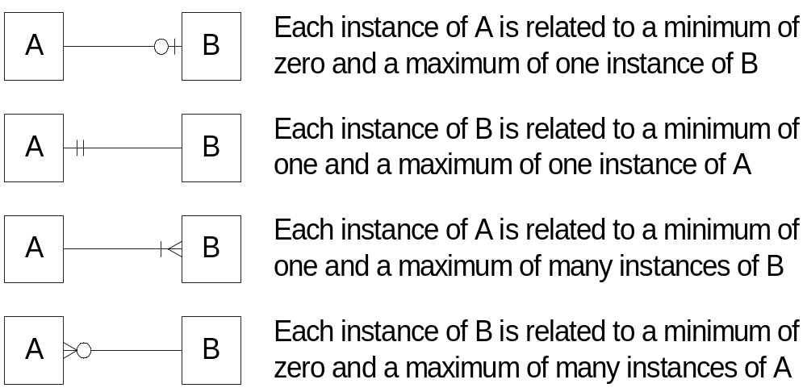
Cardinality Examples

Slide 21
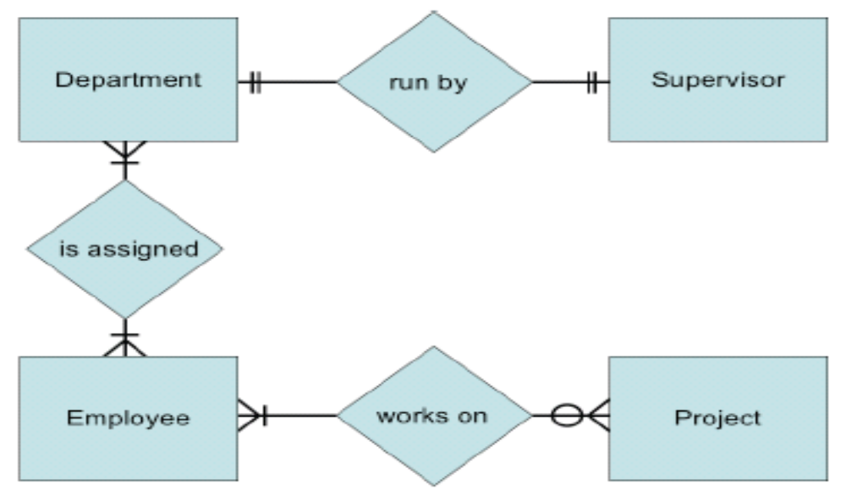
ERD with cardinality

Slide 22
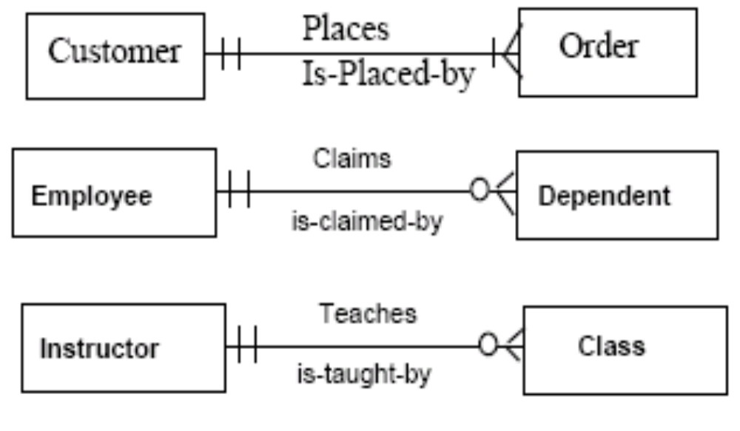
Examples

Slide 23
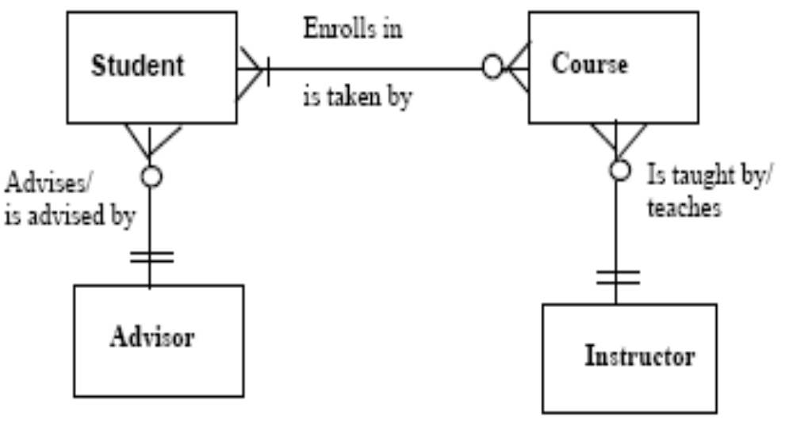
ERD for Course Enrollment

Slide 24
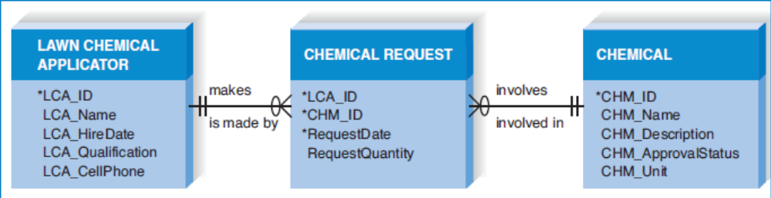
ERD for Lawn Chemical Applicator (A previous example)
7 - <number>
PowerPoint Presentation for Dennis, Wixom, & Roth Systems Analysis and Design, 3rd Edition
Copyright 2006 © John Wiley & Sons, Inc. All rights reserved.
.
Notes:
In this partial ERD, the data from this case is organised into three main categories: Lawn Chemical Applicator, Chemical Request, and Chemical. The Lawn Chemical
Applicator data describe the employees who apply the lawn chemicals. The Chemical Request data capture information about every chemical request event,
and the chemical data describe the chemicals used for lawn care.

Slide 25
Advanced Syntax
Independent Entity
  Can exist without the help of another entity
  Identifiers created from the entity’s own attributes
  Attributes from other entities are not needed to uniquely identify instances of these entities
Dependent Entity
  Relationships when a child entity does require attributes from the parent entity to uniquely identify an instance
7 - <number>
PowerPoint Presentation for Dennis, Wixom, & Roth Systems Analysis and Design, 3rd Edition
Copyright 2006 © John Wiley & Sons, Inc. All rights reserved.
.
Notes:
A good example of a dependent entity is the Chemical Request entity shown in previous example. A Chemical Request is made by a specific LCA and includes a
specific chemical. We include the LCA_ID and the Chemical_ID plus the request date to fully identify each Chemical Request.

Slide 26
Advanced Syntax
Intersection Entity
  The process of adding an intersection entity is called “resolving an M:N relationship”
  Exists in order to capture some information about the relationship that exists between two other entities. Typically, intersection entities are added to a data model to store information about two entities sharing an M : N relationship.
7 - <number>
PowerPoint Presentation for Dennis, Wixom, & Roth Systems Analysis and Design, 3rd Edition
Copyright 2006 © John Wiley & Sons, Inc. All rights reserved.
.

Slide 27
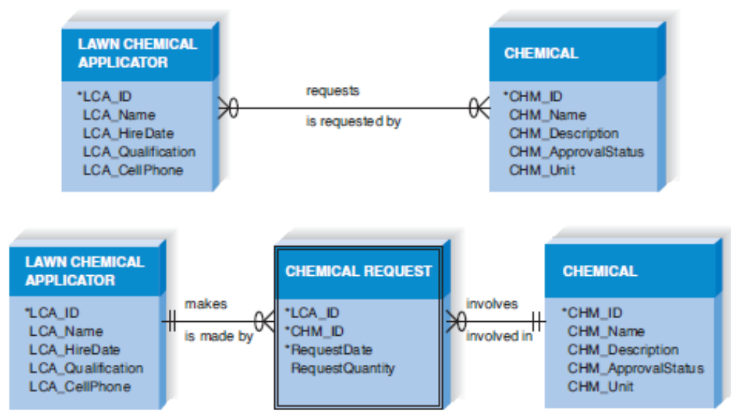
Advanced Syntax – Resolving an M : N Relationship
7 - <number>
PowerPoint Presentation for Dennis, Wixom, & Roth Systems Analysis and Design, 3rd Edition
Copyright 2006 © John Wiley & Sons, Inc. All rights reserved.
.
Notes:
Think back to the M:N relationship between LCA and Chemical in previous example. In that figure, one instance of an LCA could request many Chemicals, and a Chemical can be requested by many LCAs. A difficulty arises if we want to capture the date on which a particular chemical was requested by a specific LCA. We cannot put the date in the Chemical entity, because the Chemical is requested by many LCAs. We also cannot put the date in the LCA entity, because there are many Chemicals requested by the LCA. Therefore, we need another entity that enables us to associate a specific chemical with a specific LCA on a specific date

Slide 28
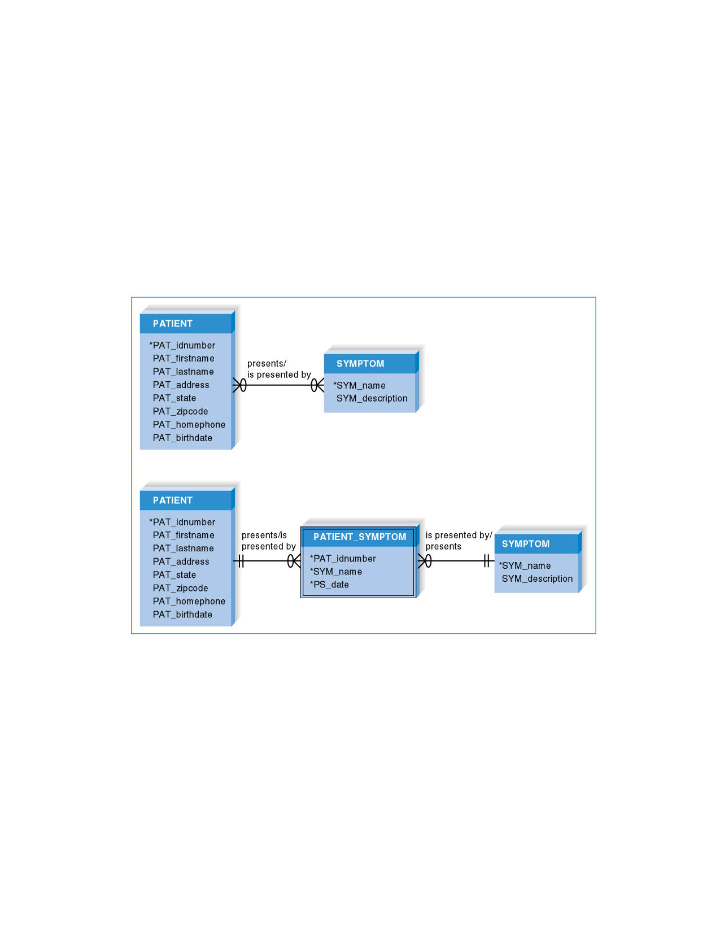
Advanced Syntax – Resolving an M : N Relationship
7 - <number>
PowerPoint Presentation for Dennis, Wixom, & Roth Systems Analysis and Design, 3rd Edition
Copyright 2006 © John Wiley & Sons, Inc. All rights reserved.
.

Slide 29
VALIDATING AN ERD
7 - <number>
PowerPoint Presentation for Dennis, Wixom, & Roth Systems Analysis and Design, 3rd Edition
Copyright 2006 © John Wiley & Sons, Inc. All rights reserved.
.

Slide 30
Check ERD Results
Look at your diagram from the point of view of a system owner or user. Is everything clear?
Check through the Cardinality pairs.
Also, look over the list of attributes associated with each entity to see if anything has been omitted.

Slide 31
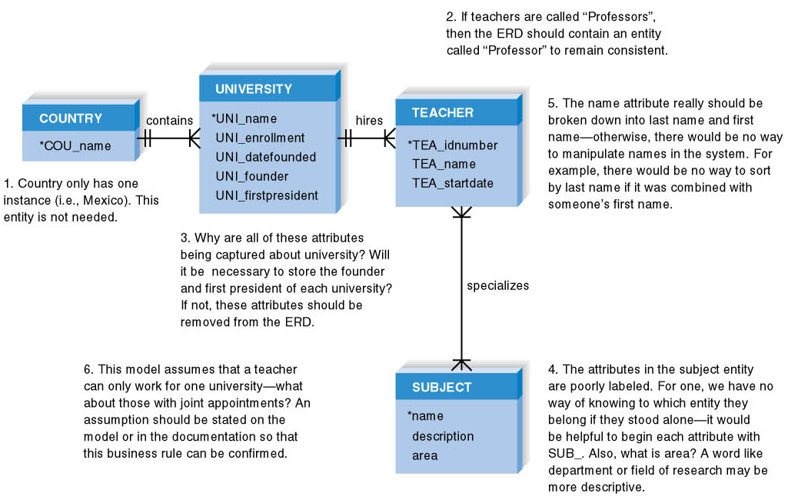
Design Modeling Guidelines Summary
7 - <number>
PowerPoint Presentation for Dennis, Wixom, & Roth Systems Analysis and Design, 3rd Edition
Copyright 2006 © John Wiley & Sons, Inc. All rights reserved.
.

Slide 32
Balancing ERDs with DFDs
All analysis activities are interrelated
Process models contain two data components
  Data flows and data stores
The DFD data components need to balance the ERD’s data stores (entities) and data elements (attributes)
Check that all data stores and elements correspond between models
  Data that is not used is unnecessary
  Data that has been omitted results in an incomplete system
Do not follow thoughtlessly -- check that the models make sense!
7 - <number>
PowerPoint Presentation for Dennis, Wixom, & Roth Systems Analysis and Design, 3rd Edition
Copyright 2006 © John Wiley & Sons, Inc. All rights reserved.
.

Slide 33
Problems with ER models
Problems may arise when designing a conceptual data model called connection traps.
Often due to a misinterpretation of the meaning of certain relationships.
Two main types of connection traps are called fan traps and chasm traps.

Slide 34
Fan Trap – Where a model represents a relationship between entity types, but pathway between certain entity occurrences is ambiguous. Exists when two or more 1:* relationships fan out from the same entity
Chasm Trap – Where a model suggests the existence of a relationship between entity types, but pathway does not exist between certain entity occurrences. Eg may occur where there are one or more relationships with a minimum multiplicity of zero (ie optional participation) forming part of the pathway between related entities.

Slide 35

An Example of a Fan Trap

Slide 36
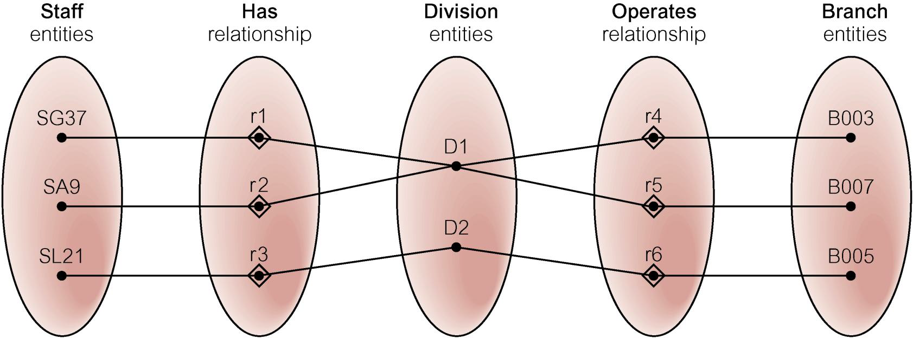
An Example of a Fan Trap
Semantic Net of ER Model with Fan Trap
At which branch office does staff number SG37 work?

Slide 37
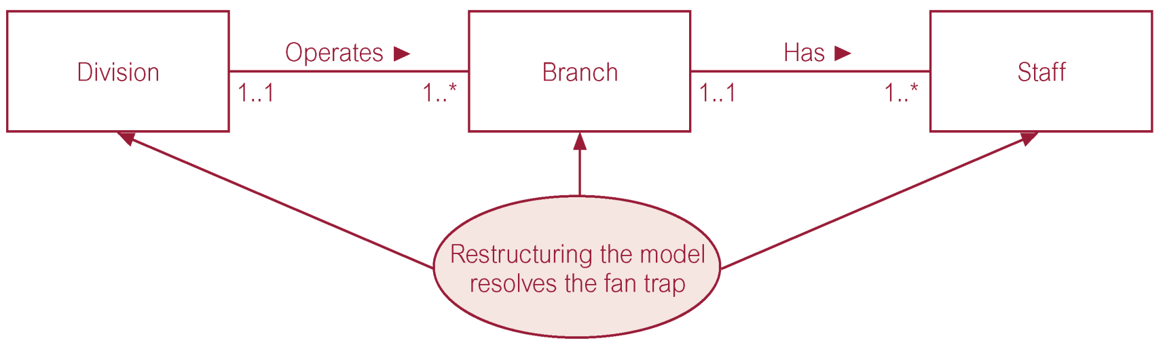
An Example of a Fan Trap
Restructuring ER model to remove Fan Trap

Slide 38
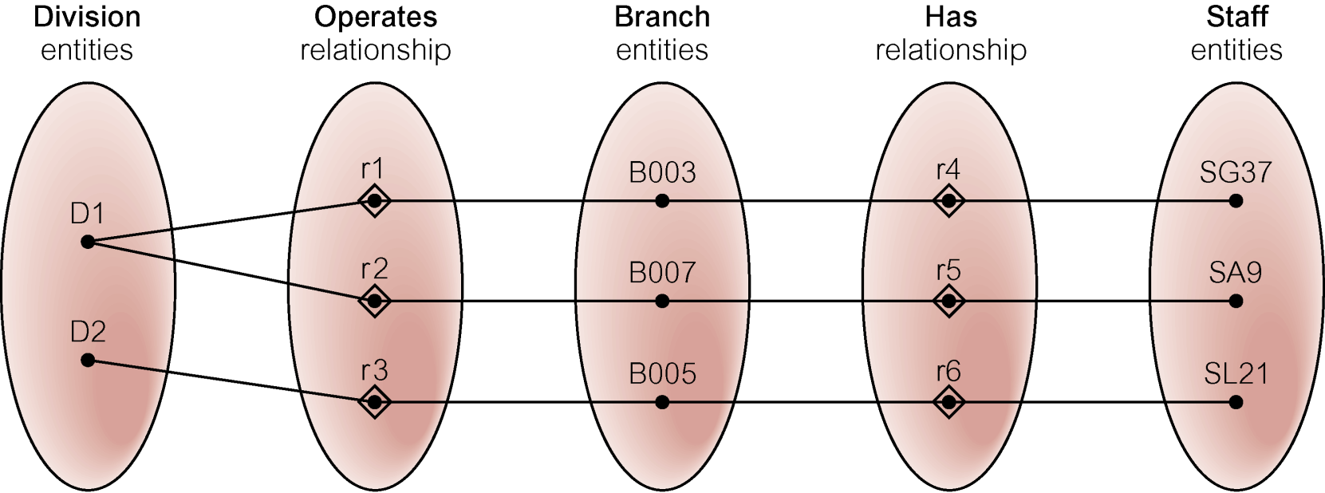
An Example of a Fan Trap
Semantic Net of Restructured ER Model with Fan Trap Removed
SG37 works at branch B003.

Slide 39

An Example of a Chasm Trap

Slide 40
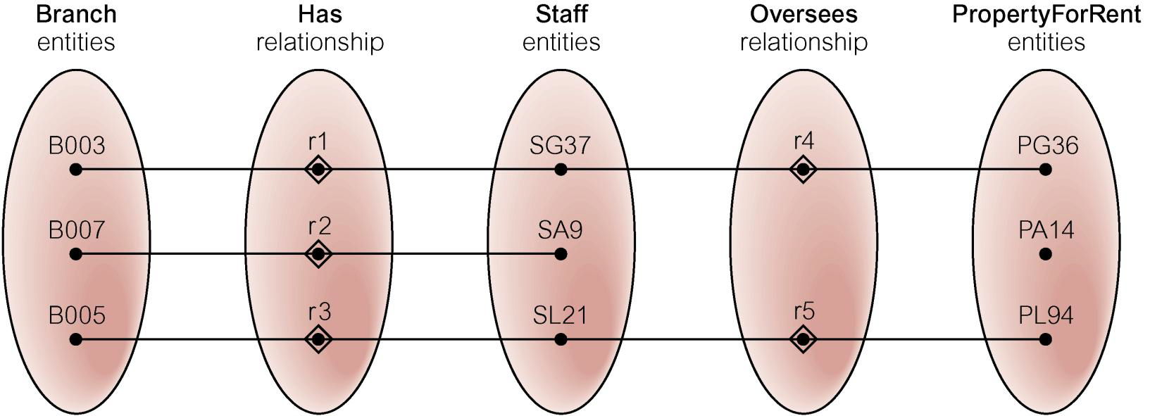
An Example of a Chasm Trap
Semantic Net of ER Model with Chasm Trap
At which branch office is property PA14 available?

Slide 41
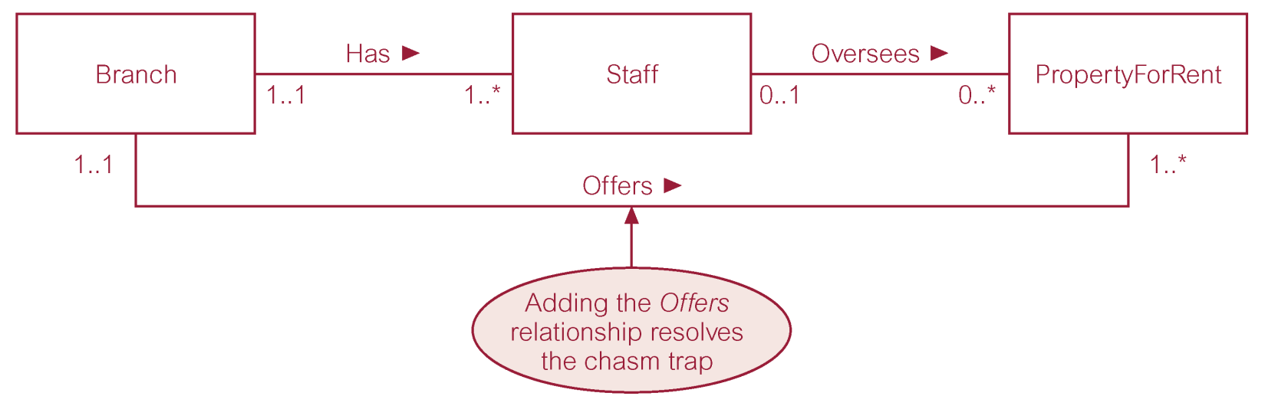
An Example of a Chasm Trap
ER Model restructured to remove Chasm Trap

Slide 42
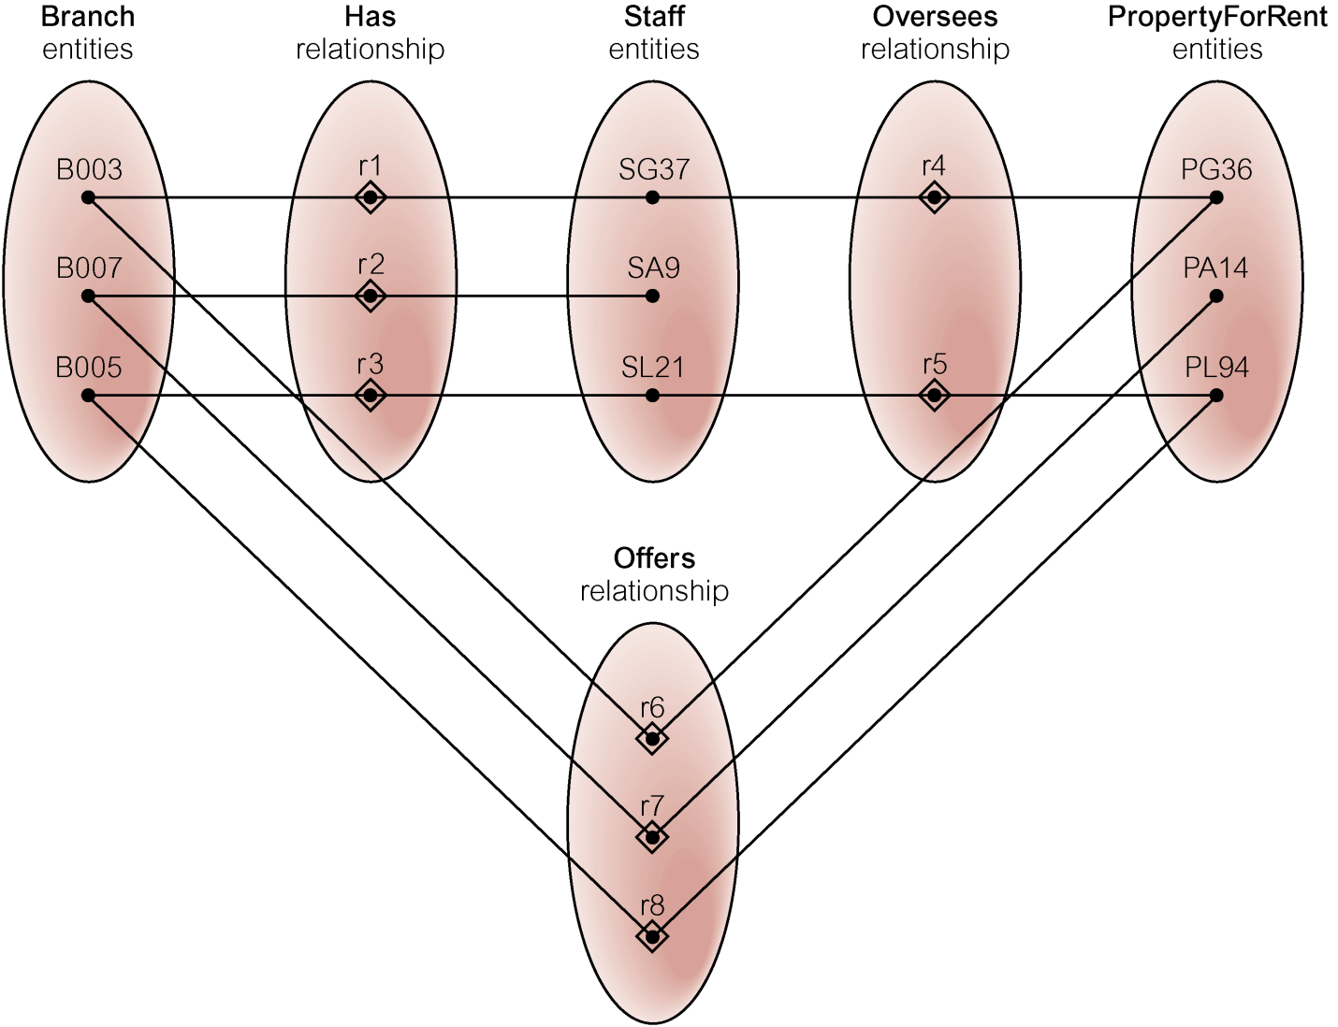
An Example of a Chasm Trap
Semantic Net of Restructured ER Model with Chasm Trap Removed

Slide 43
Summary
The ERD is the most common technique for drawing data models. The building blocks of the ERD are:
  Entities describe people, places, or things
  Attributes capture information about the entity
  Relationships associate data across entities
Intersection, dependent, and independent entities must be recognized.
The ERD must be balanced with the DFD.
7 - <number>
PowerPoint Presentation for Dennis, Wixom, & Roth Systems Analysis and Design, 3rd Edition
Copyright 2006 © John Wiley & Sons, Inc. All rights reserved.
.

